Slide 1
EquiFlow
IoT Sensors
Edge Computing
IoT-Enabled Retrofit Hydraulic Digital Twin
Digital Twin
for Smart Water Distribution Networks
AI Analytics
Smart Water Distribution Through Edge Intelligence, Leak Detection & Predictive Analytics
LoRaWAN
Project EquiFlow | Team – Mind Flayers | Smart Cities Division

Slide 2

Problem Statement
Urban Water Distribution – Key Challenges
Urban water distribution networks face critical operational, equity, and sustainability challenges. Rapid urbanization combined with aging infrastructure has amplified these issues, creating an urgent need for smarter, cost-effective water management solutions.
01
Unequal Water Distribution
02
Undetected Pipeline Leakages
Low-altitude zones receive excess pressure while high-altitude areas suffer inadequate supply.
Residents in upper areas rely on expensive private tankers or supplementary pumps.
Static pipe networks cannot adapt to dynamic demand or topographic variation.
Leakages often go undetected for weeks or months — causing significant water loss.
Non-Revenue Water (NRW) exceeds 30–50% in many Indian cities due to physical losses.
Conventional detection (acoustic sensors, tracer gas) is expensive and episodic.
03
High Cost of Modernization
04
Lack of Predictive Intelligence
Traditional smart-water upgrades require pipeline excavation and replacement.
Ward-level pipeline projects cost ₹2–5 crore; city-wide programs run into hundreds of crores.
Long civil timelines cause road closures, public disruption, and delays.
Current systems operate reactively — responding only after failures occur.
No mechanism to forecast water-stressed or surplus zones before issues arise.
Absence of data-driven demand analysis leads to inefficient resource allocation.

Slide 3
Proposed Solution – EquiFlow
IoT-Enabled Retrofit Hydraulic Digital Twin for Smart Water Distribution
EquiFlow is an IoT-enabled Retrofit Hydraulic Digital Twin that modernizes existing water distribution networks without excavation or pipeline replacement. It overlays sensing, edge intelligence, communication, automated actuation, and cloud analytics onto existing infrastructure — creating a live digital mirror of the physical network.
SENSING
Dual Flow Sensor Network
LEAK DETECTION
3-Condition Leak Detection
Inlet and outlet flow meters, pressure sensors, TDS and chlorine sensors installed at every zone node. Non-invasive clamp-on installation — no pipe cutting required. Data sampled at configurable 1-second to 5-minute intervals.
Continuous monitoring using a 3-condition validation logic that analyzes flow behavior, persistence patterns, and operational context to identify potential leakages while minimizing false alerts.
ACTUATION
Smart Servo Valve Regulation
EDGE COMPUTING
ESP32 / STM32 Edge Node
Motorized butterfly valves at junction nodes receive real-time control signals from the Edge Control Node. Dynamically throttle low-altitude zones and boost high-altitude supply. Autonomous, semi-auto, and manual modes supported.
Local processing for leak detection, sensor validation, threshold logic, and valve control decisions. Critical operations execute on-device — fully functional during communication outages. AES-128 encrypted LoRaWAN packet assembly.
DIGITAL TWIN
Real-Time Digital Twin Dashboard
AI & SCADA
AI Zone Analysis & SCADA Integration
GIS-based React.js + Mapbox GL JS dashboard shows live network state: zone pressures, flow rates, leak flags, and valve positions overlaid on actual pipeline geography. Historical analytics and AI zone health scores surfaced in context.
ML models trained on historical sensor data predict water-stressed and surplus zones before problems manifest. Native SCADA integration via REST APIs and Modbus TCP/IP — EquiFlow augments existing control infrastructure without replacing it.

Slide 4
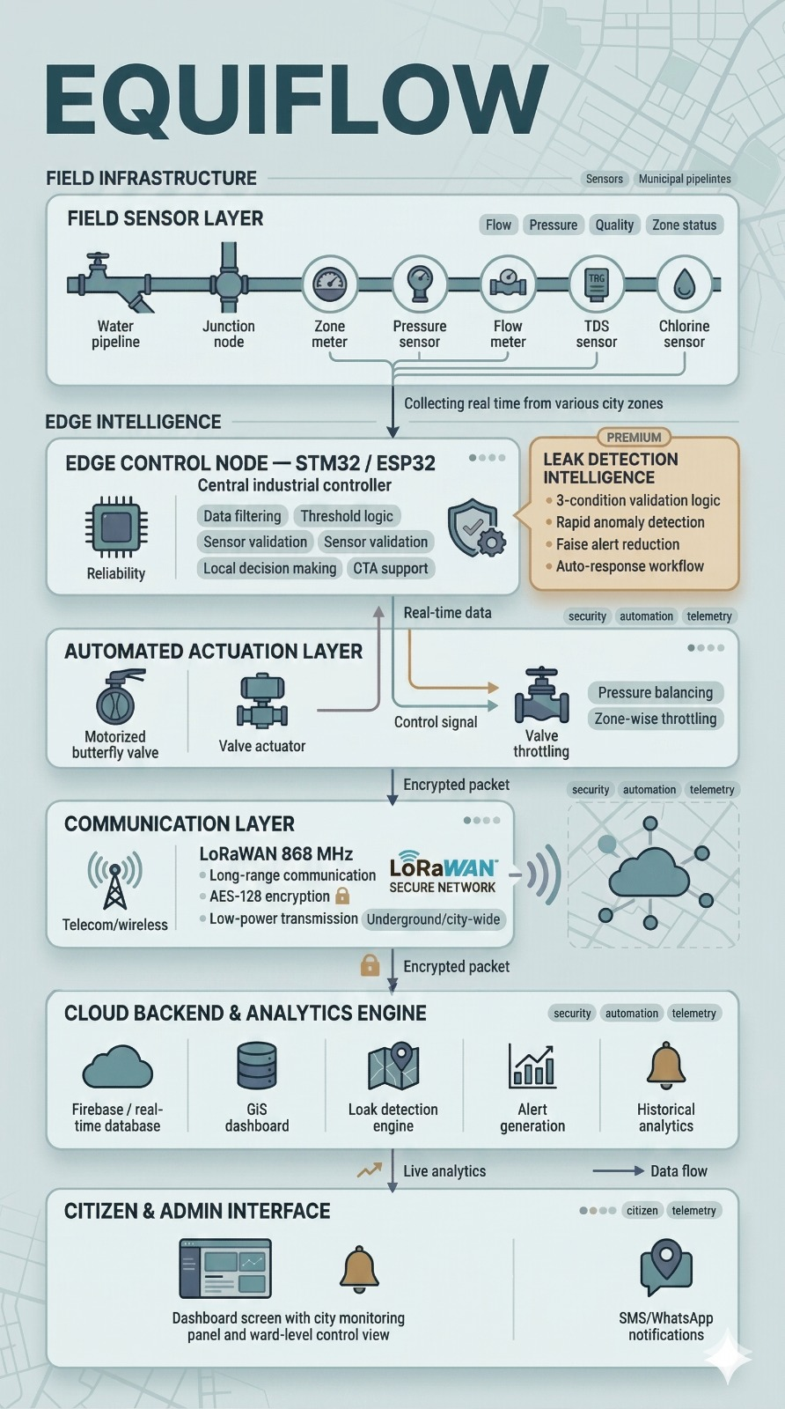
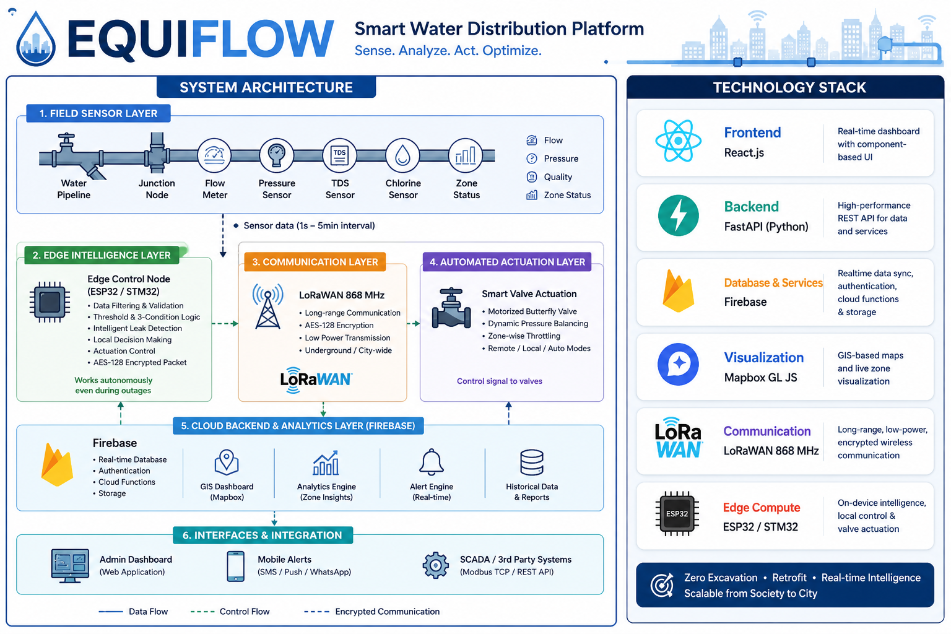
Technology Stack
Purpose-Built Selection Across Every Layer
TECHNOLOGY STACK
Real-Time Leak Detection:
Continuously monitors network conditions to identify potential leakages and abnormal flow patterns.
Smart Flow Regulation:
Automatically regulates valve operations to maintain balanced water distribution across zones.
Digital Twin Monitoring:
Provides a live digital view of the entire water distribution network for real-time monitoring.
SCADA Compatibility:
Integrates seamlessly with existing supervisory and control systems without replacement.
AI-Based Zone Analysis:
Analyzes operational data to identify potential water-stressed and surplus regions.
Zero-Excavation Retrofit:
Enables rapid deployment without pipeline replacement or excavation work.
Real time dashboard with UI component
High-performance REST API for Data and Services
Real-time database, authentication, and live data synchronization.
GIS-based maps and visualization
Long-range, low-power, encrypted wireless communication
On-Device Intelligence,
local control &
Valve Actuation
EquiFlow System Architecture

Slide 5
Expected Impact
Quantified Benefits Across Social, Operational, and Environmental Dimensions
01
Equitable Water Access
04
AI-Driven Resource Planning
Inter-zone supply variation reduced to ≤10% from 40–60%
Proactive zone management — stress predicted weeks in advance
Autonomous valve balancing redistributes flow to high-altitude zones continuously.
Eliminates dependence on private water tankers — saving ₹2,000–5,000/month per household in deficit areas.
Real-time pressure monitoring ensures service reliability across all zones equally.
ML models identify trending water-stressed zones before supply deficit manifests.
Historical consumption analysis enables demand-side planning and supply reallocation.
02
Water Conservation
05
Smart City & Municipal Efficiency
NRW reduced by 20–30% within Year 1 of deployment
Operational monitoring area per operator: 10x improvement
Continuous leak detection identifies events within 15–30 minutes vs weeks in current systems.
For a 100 MLD network at 35% NRW: 7 million litres/day recovered — saving ≈₹1.28 cr/year in treatment costs.
TDS and chlorine monitoring prevents quality-driven supply shutdowns.
Small control room team manages entire ward network with automated alerts.
Integrates with ICCC (Integrated Command & Control Centre) via open APIs.
Regulatory compliance reports auto-generated from historical analytics data.
03
Cost-Effective Modernization
Scalability at a Glance
Capital cost 20–30% of traditional SCADA/pipeline replacement
Context | Zones | Sensors | Gateways
Housing Society | 1–3 | 6–18 | 1
Municipal Ward | 20–50 | 120–300 | 3–5
Full Smart City | 500+ | 3000+ | 50+
Single ward-level EquiFlow deployment (30 zones): ₹25–50 lakhs vs ₹2–5 crore conventional.
Zero excavation: no road closures, no civil permits, deployment in 2–3 days per zone.

Slide 6






Innovation & Uniqueness
Transforming conventional water networks into intelligent, data-driven, and sustainable infrastructure.
Multi-Parameter Leak Detection
Autonomous Altitude Balancing
Combines inlet–outlet flow, travel-time & pressure-drop analysis to minimize false positives.
Servo-controlled valve intelligently equalizes supply to higher-altitude zones — no extra pumps.
Edge-Based Decision Making
AI-Based Zone Analysis
Leak detection & emergency isolation execute locally on ESP32 — resilient to network outages.
Real-time + historical data identifies water-stressed & surplus zones for proactive planning.
Retrofit Digital Twin
SCADA-Compatible & Scalable
Creates a live digital mirror of the physical water network — no excavation or replacement.
Modular architecture integrates with existing SCADA systems — from housing to municipality scale.
All-in-One Platform · Zero Excavation · Low Cost · SCADA Ready · AI-Powered · City-Scalable

Slide 7
Project Roadmap
7-Phase Implementation Plan from Prototype to Municipal Deployment
Q1
Phase 1
Q1–Q2
Phase 2
Q2
Phase 3
Q2–Q3
Phase 4
System Design & Hardware Integration
Sensor Network Deployment & Data Acquisition
LoRaWAN Communication Setup
Digital Twin Dashboard Development
Finalize sensor selection: flow, pressure, TDS, chlorine meters
Design ESP32/STM32 edge node firmware architecture
Prototype non-invasive sensor mounting for all pipe materials
Complete electrical interface schematics (RS-485, 4-20mA, pulse)
Install dual flow sensors, pressure and quality sensors at testbed site
Validate data quality under operational conditions (vibration, temperature, EMI)
Tune filtering algorithms based on real-world noise profiles
Deploy LoRaWAN gateways at strategic elevated locations
Configure AES-128 network session key and application session key
Characterize packet loss, latency, and power consumption
Test penetration through building materials and underground environments
Develop React.js components: sensor panels, alerts, zone health indicators
Integrate Mapbox GL JS with GIS pipeline network data
Build real-time data binding via Firebase / WebSocket streams
Implement valve control interface and historical trend views
Q3
Phase 5
Q3–Q4
Phase 6
Q4+
Phase 7
AI Analytics Integration
Pilot Testing & Validation
Municipal Scale Deployment
Train zone health models on accumulated sensor data
Develop demand forecasting and leak probability predictors
Integrate zone health scores and alerts into dashboard
Build automated compliance report generation
3–6 month live pilot at real-world testbed with full system integration
Stress-test: simultaneous multi-zone alerts, gateway failure, power interruption
Collect operator and administrator feedback; refine UX
Document performance: detection sensitivity, false-positive rate, availability
Zone-by-zone ward rollout with zero disruption to operating zones
Municipal operator training programme delivery
SCADA and ICCC integration commissioning
Establish ongoing monitoring, reporting, and model retraining cadence

Slide 8
Research And References
Quantified Benefits Across Social, Operational, and Environmental Dimensions
1
“LoRaWAN AI-Powered Digital Twins for Smart Water Distribution Networks"
IEEE Xplore, Published: May 2025
2
"IoT Architecture Based Water Resources Conservation Management Using LoRa"
IEEE Conference Publication, ICSCGE
3
"Application-Aware LoRaWAN Gateway Placement in Massive IoT Water Distribution Networks“
IEEE Xplore, Published: Dec 2024
4
"AI-Enhanced Digital Twin Platform for Smart Water Distribution: Integrating Machine Learning Models with IoT-Driven Predictive Analytics"
Preprints/Digital Twins, Published: Oct 2025
5
"IoT Enabled Water Distribution System for Smart Water Management"
Journal Publication, 2024

